Slide 1
P435-1: DGE
Thomas H. Edwards
Bioinformatician I
20240409

Slide 2
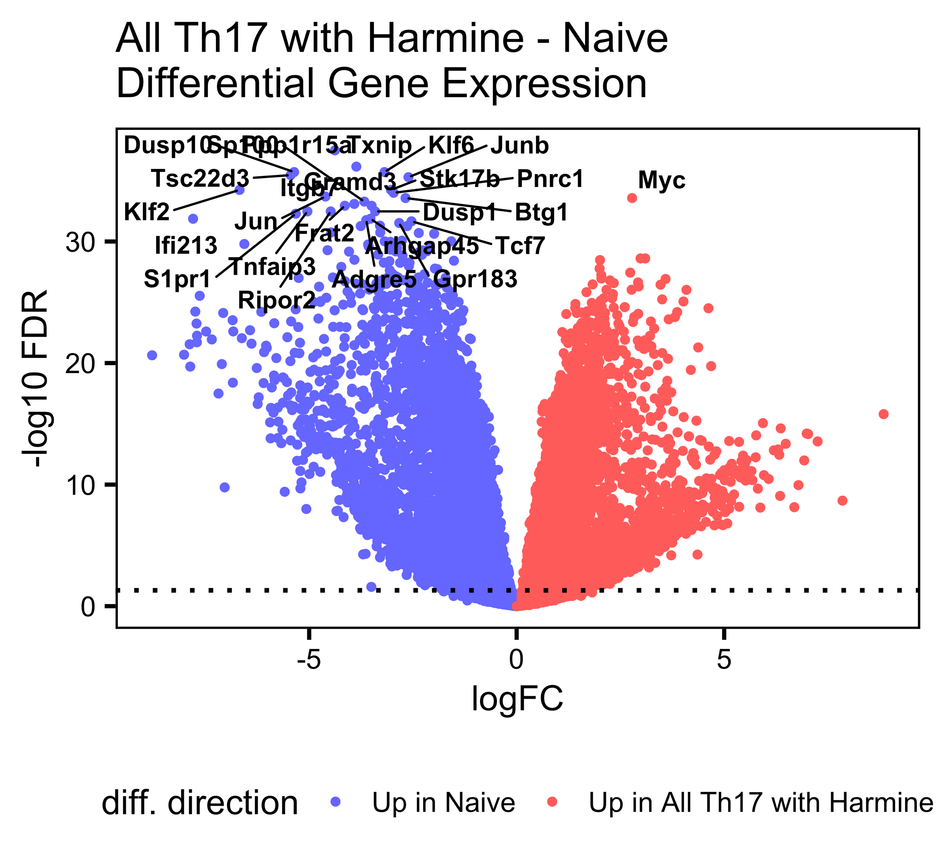
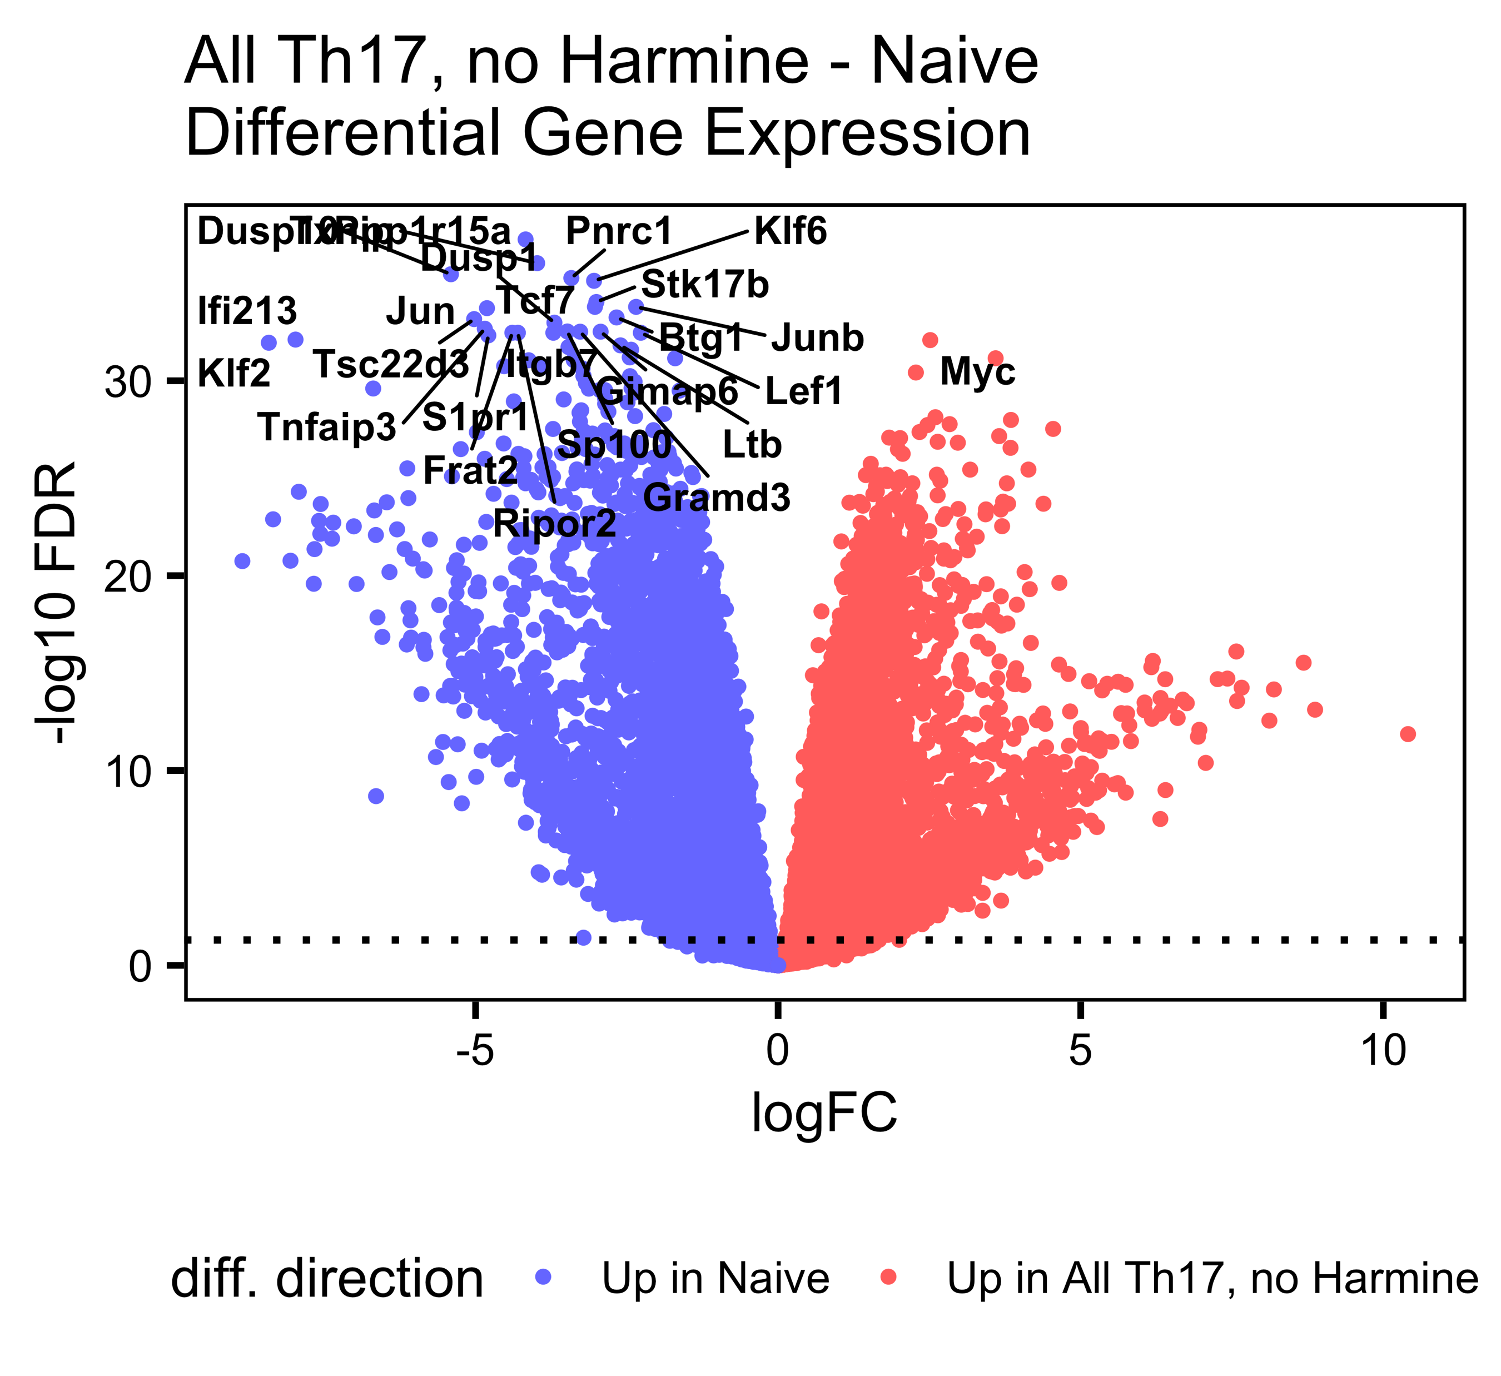
Th17-naïve DGE, all timepoints, split by harmine

Slide 3
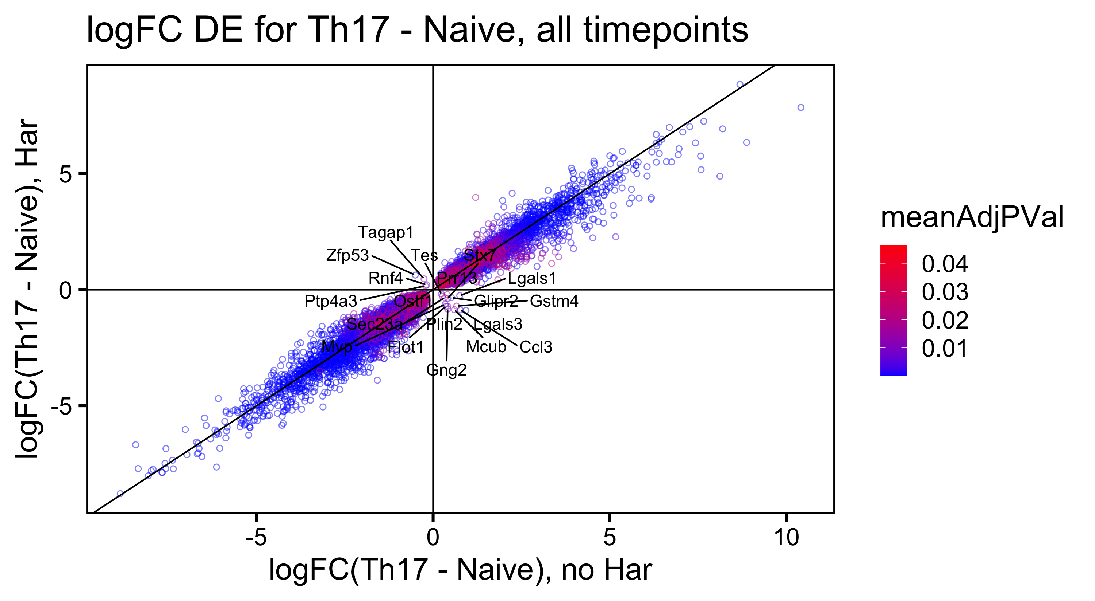
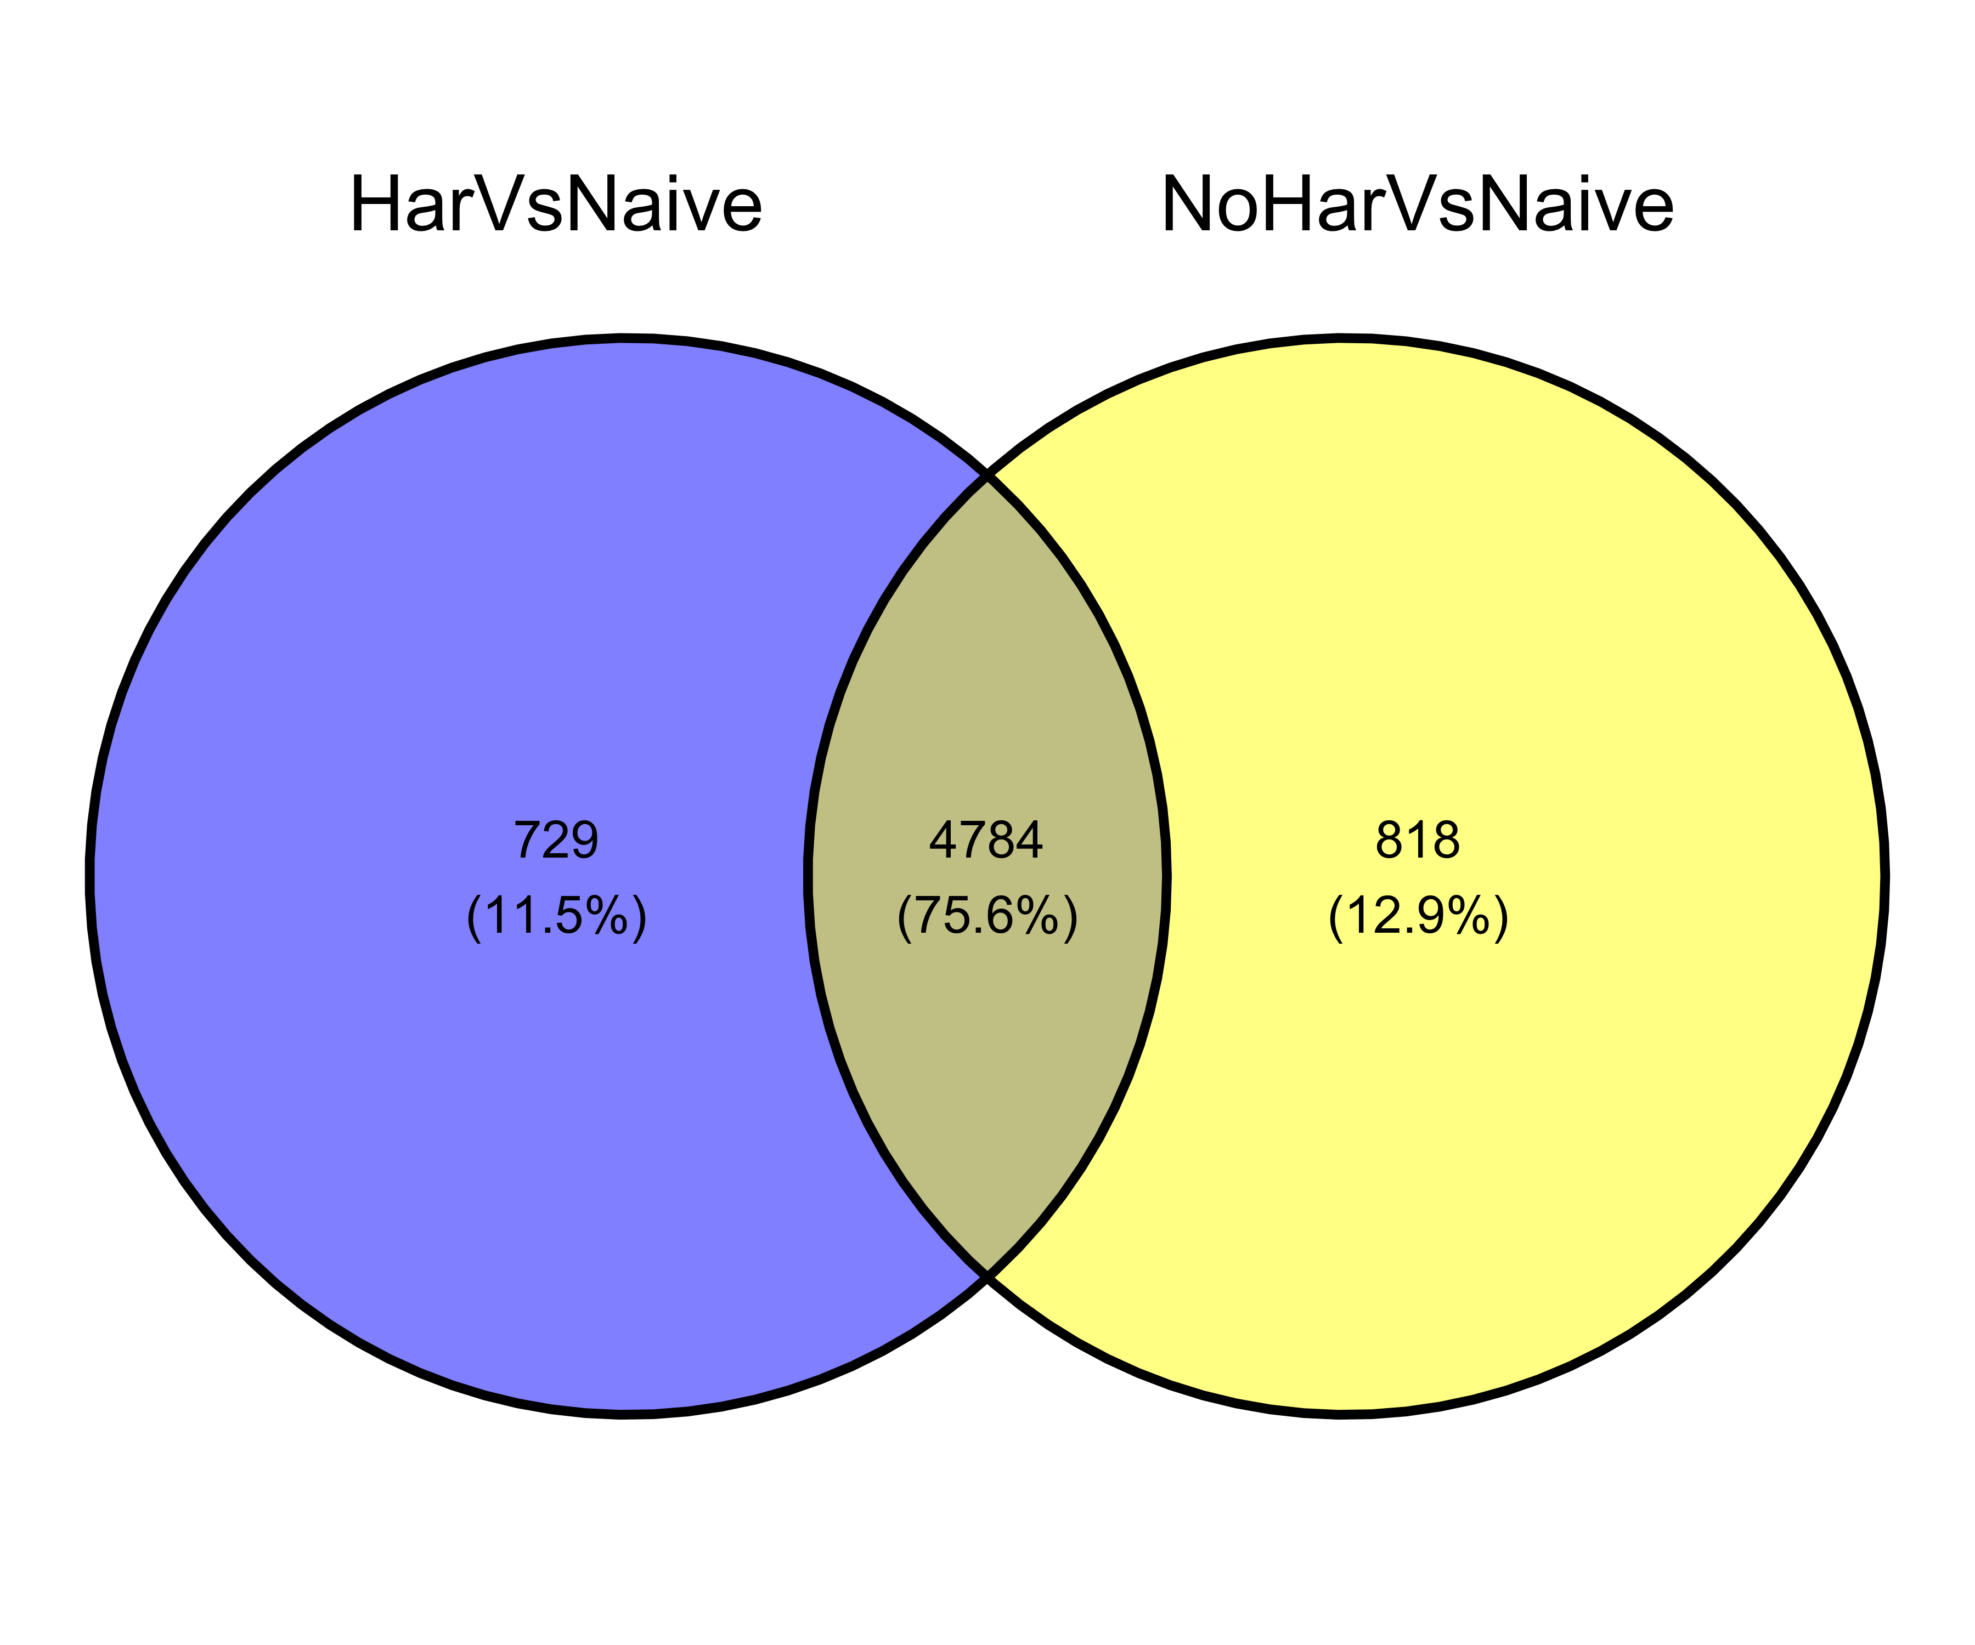
Logfc scatterplot: off-diags are different between the two dge comparisons
DEG overlap:
adj.p.val < 0.05 |LogFC| > 1

Slide 4
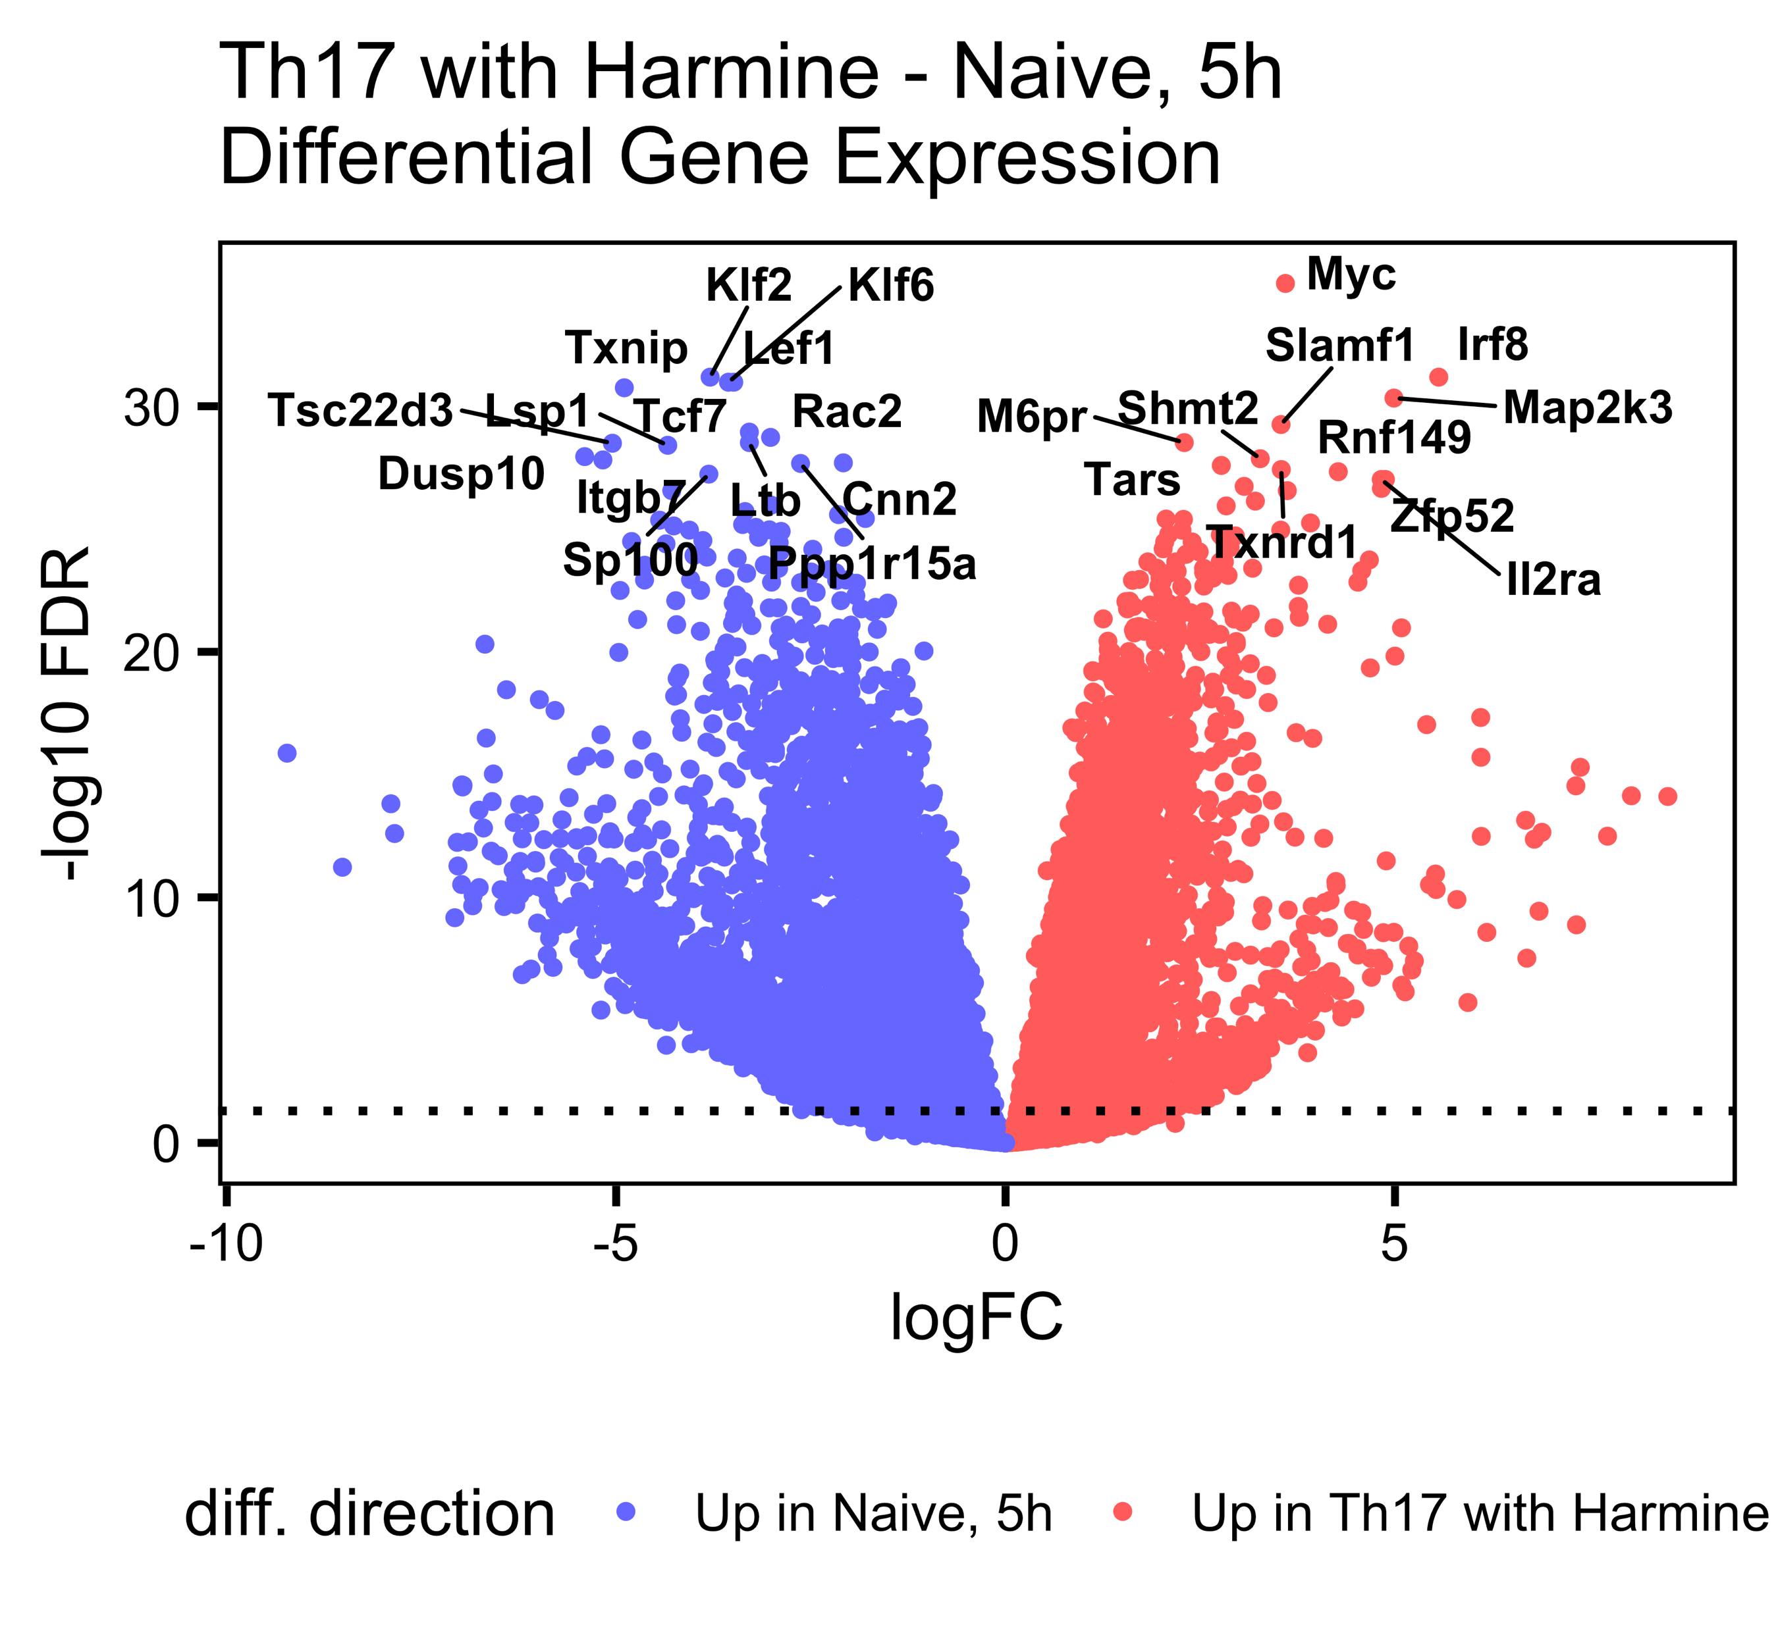
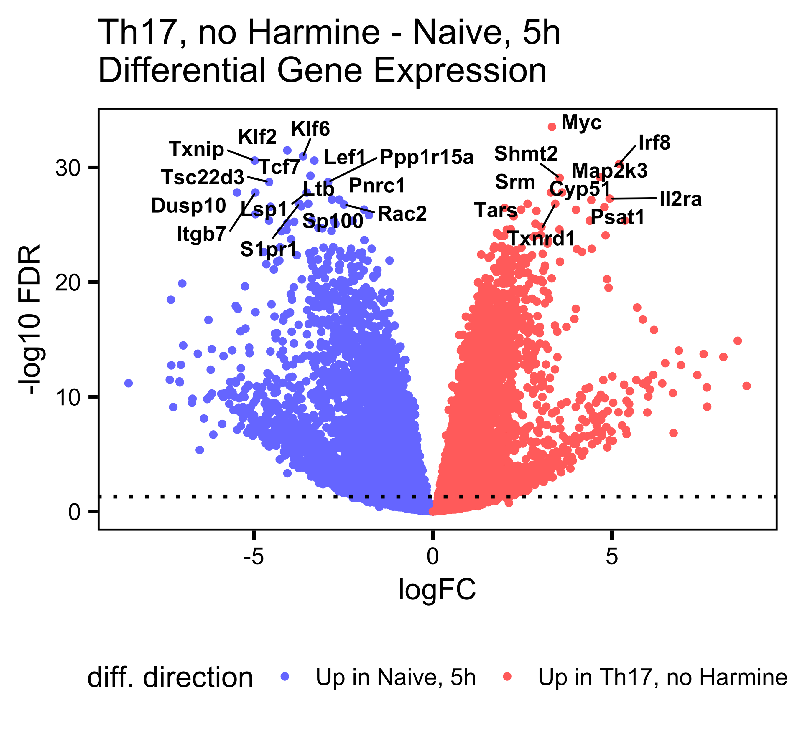
Th17-naïve DGE, 5h, split by harmine

Slide 5
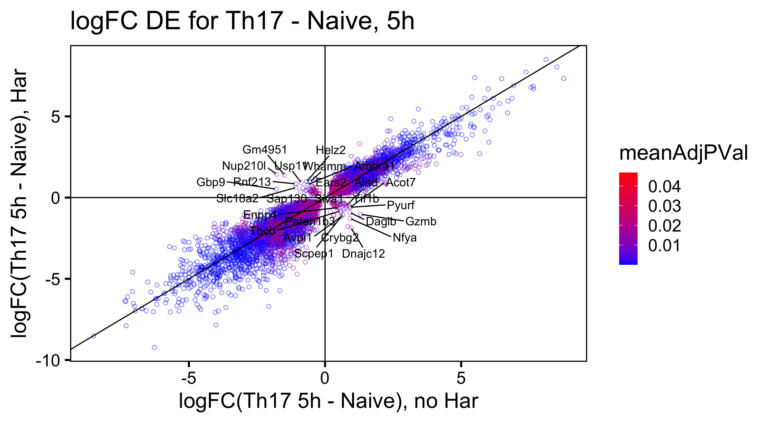

Logfc scatterplot: off-diags are different between the two dge comparisons
DEG overlap:
adj.p.val < 0.05 |LogFC| > 1

Slide 6
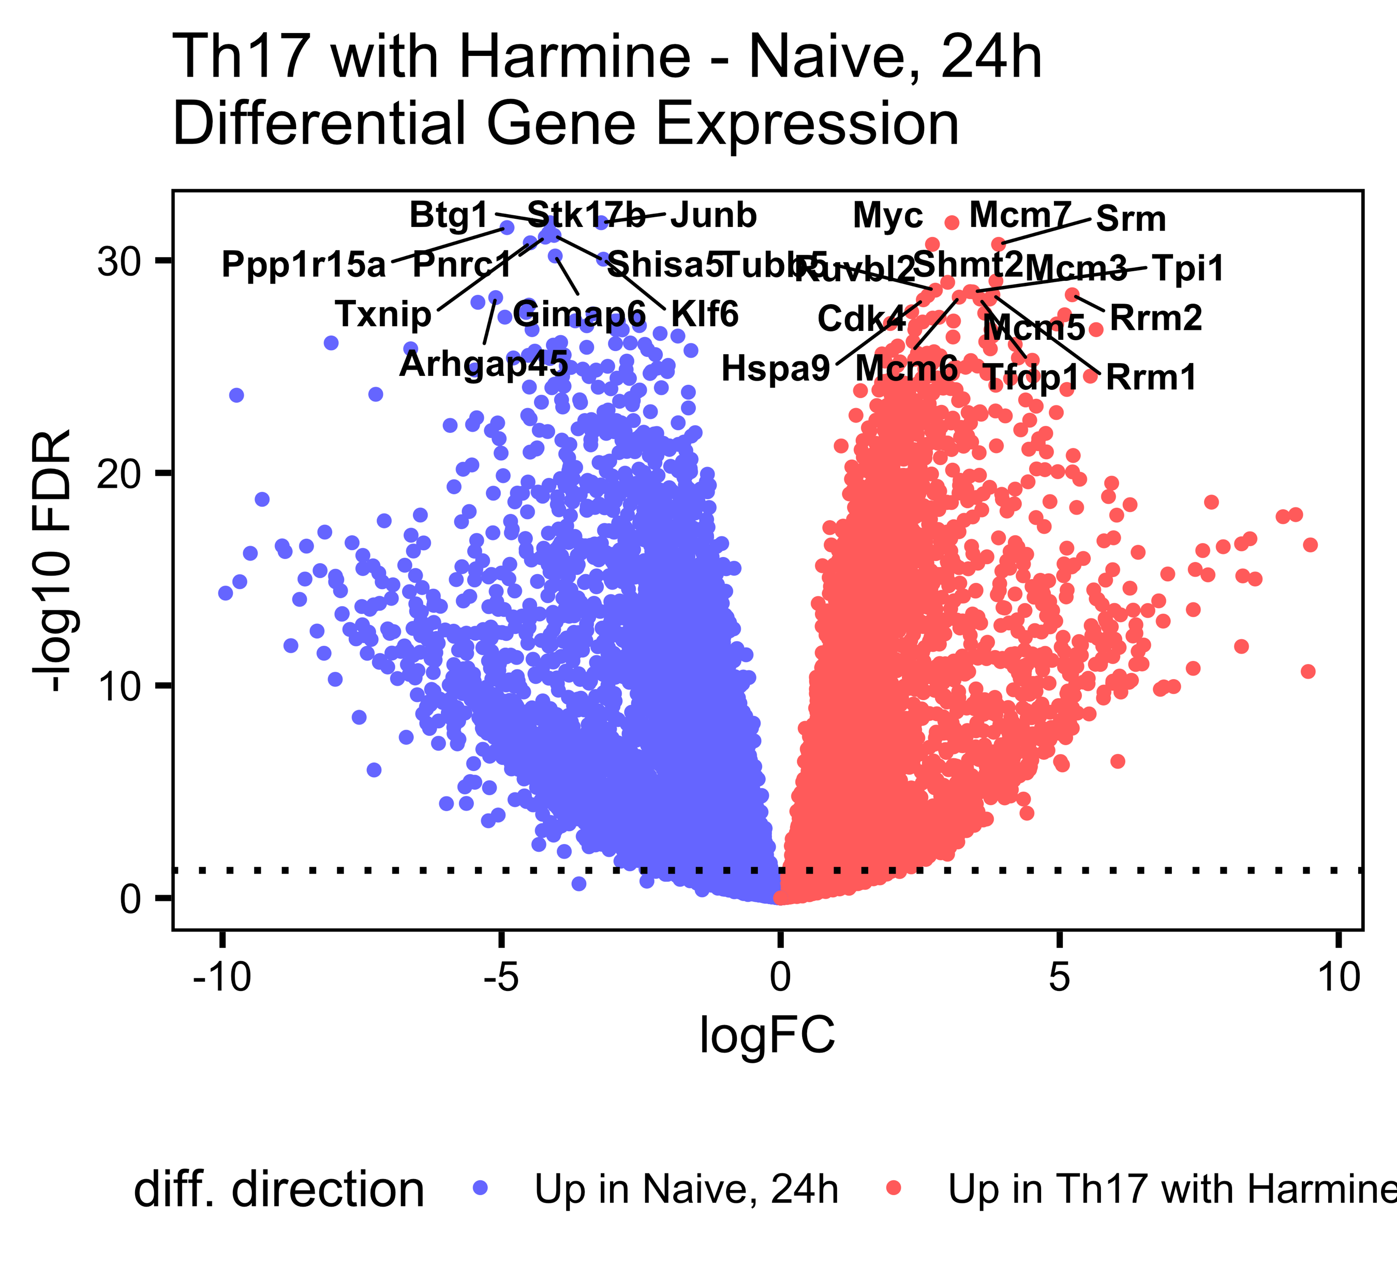
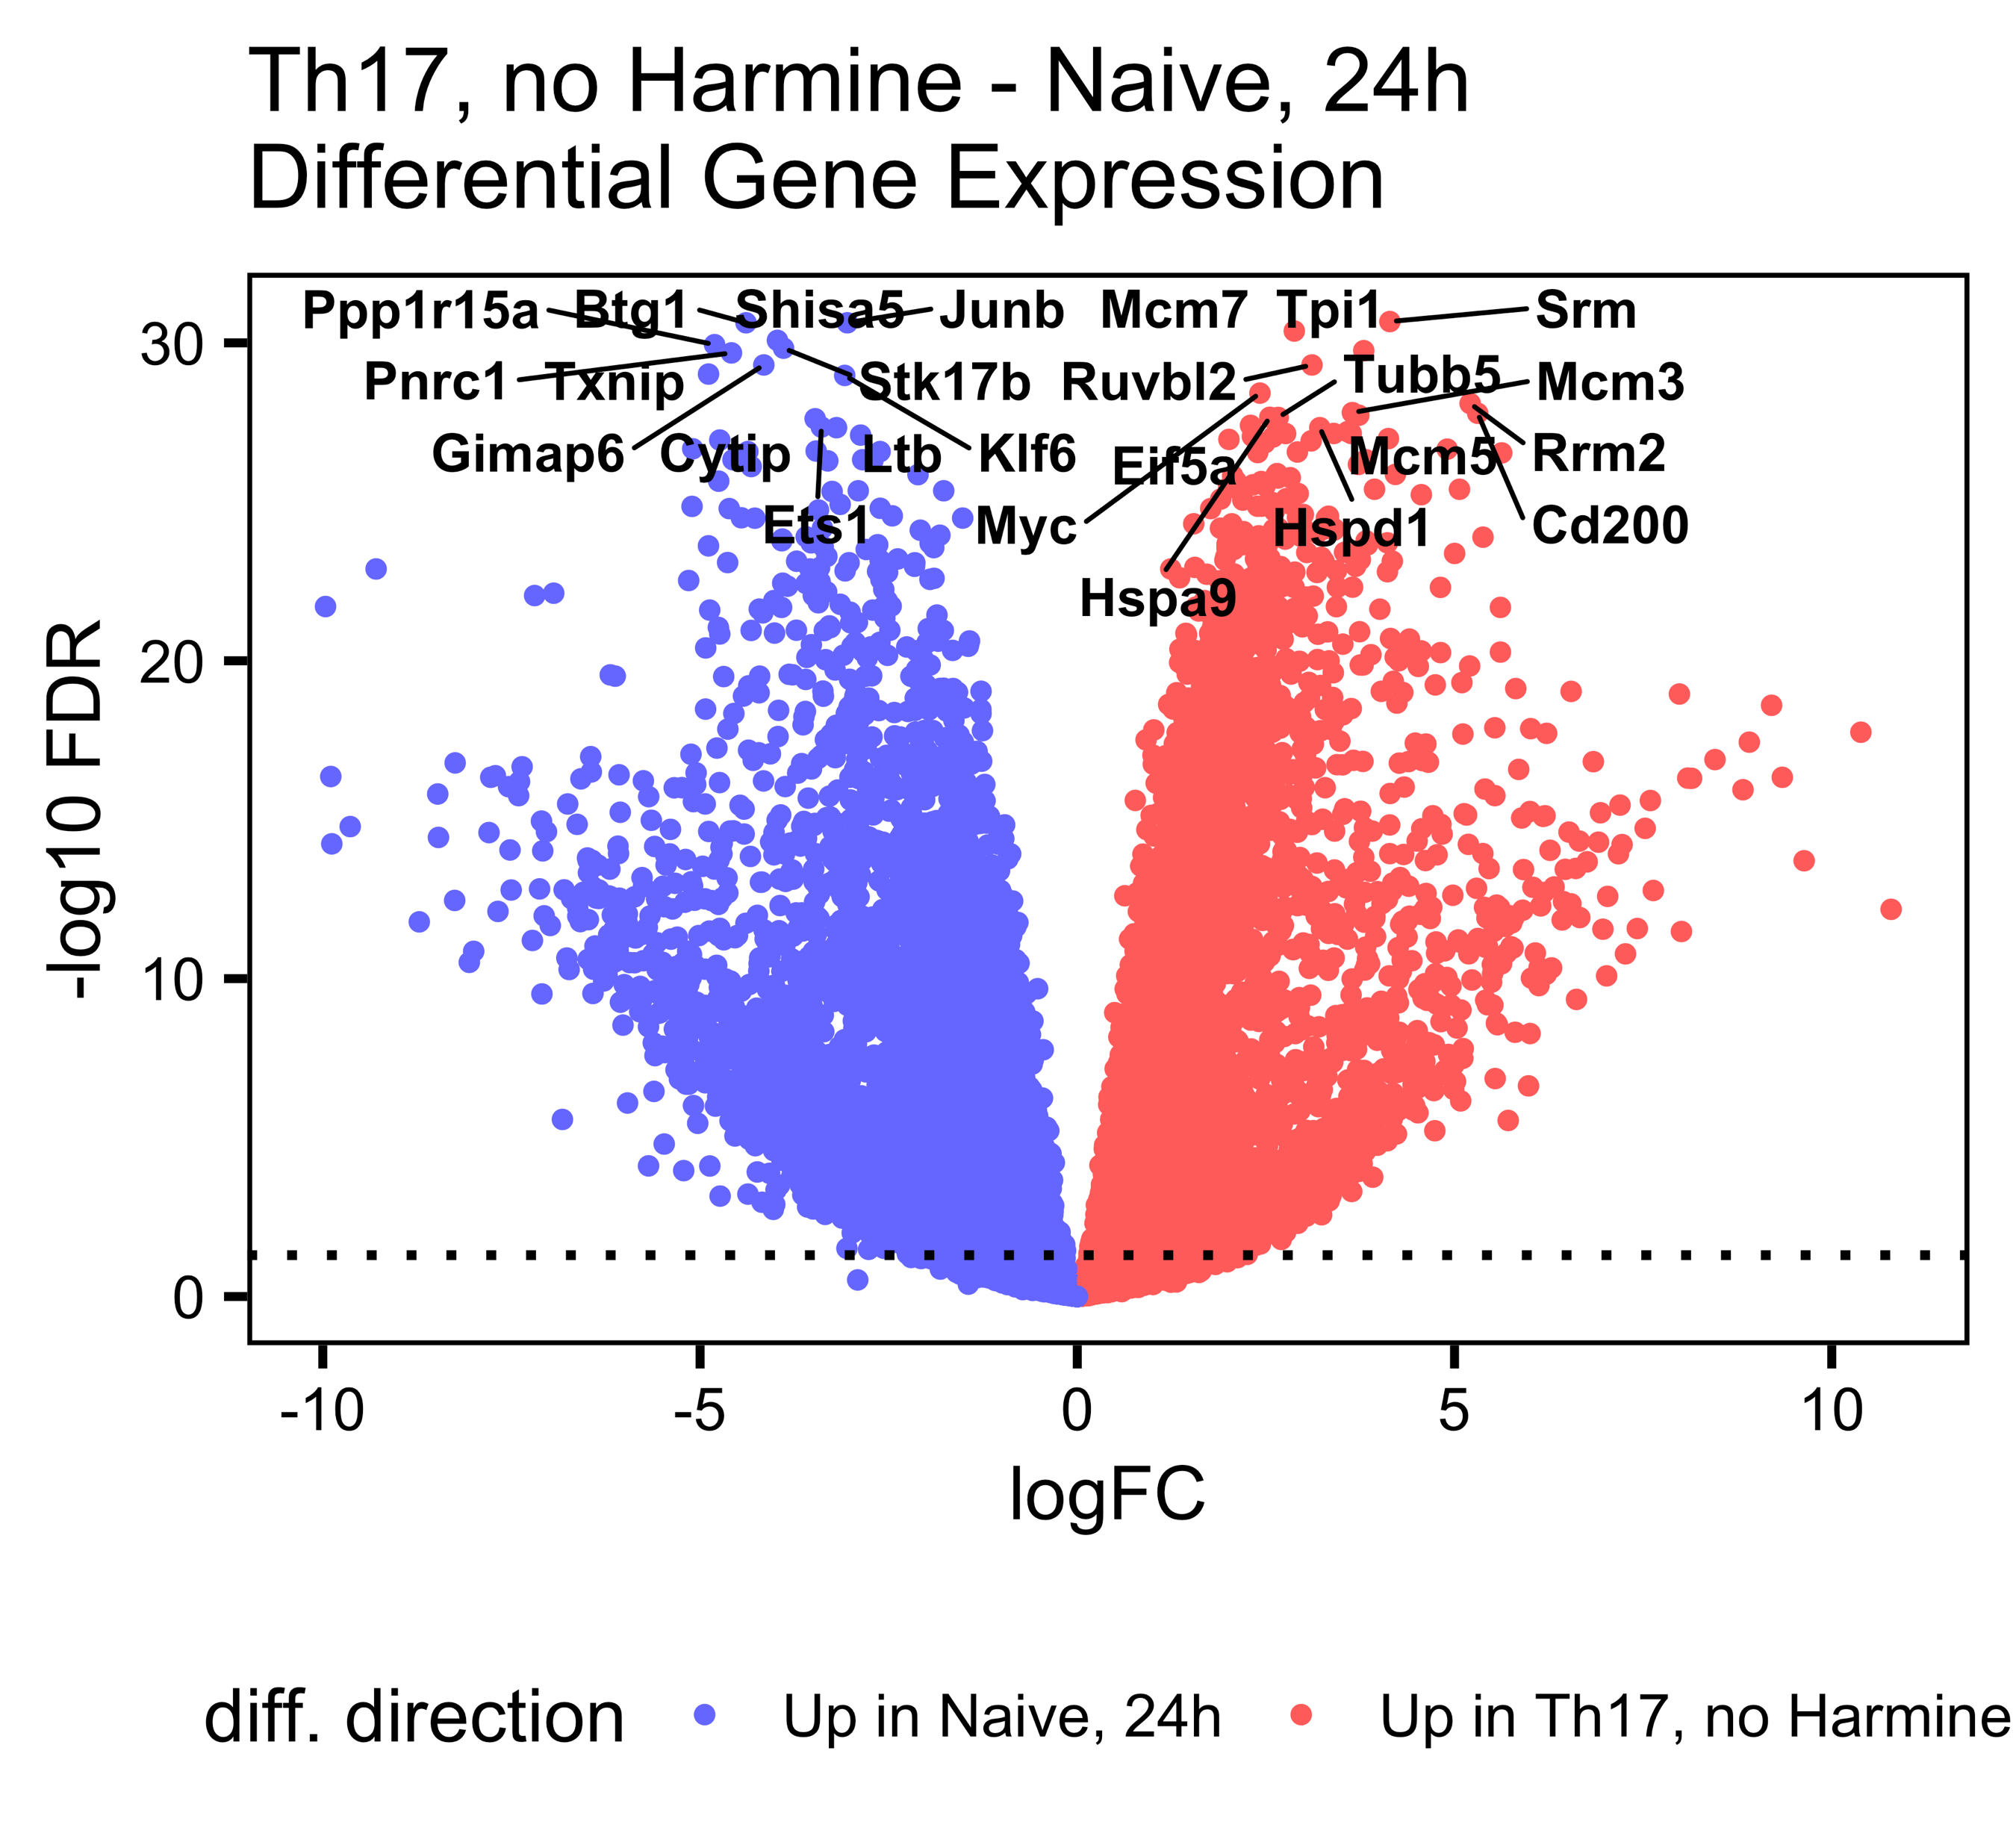
Th17-naïve DGE, 24h, split by harmine

Slide 7
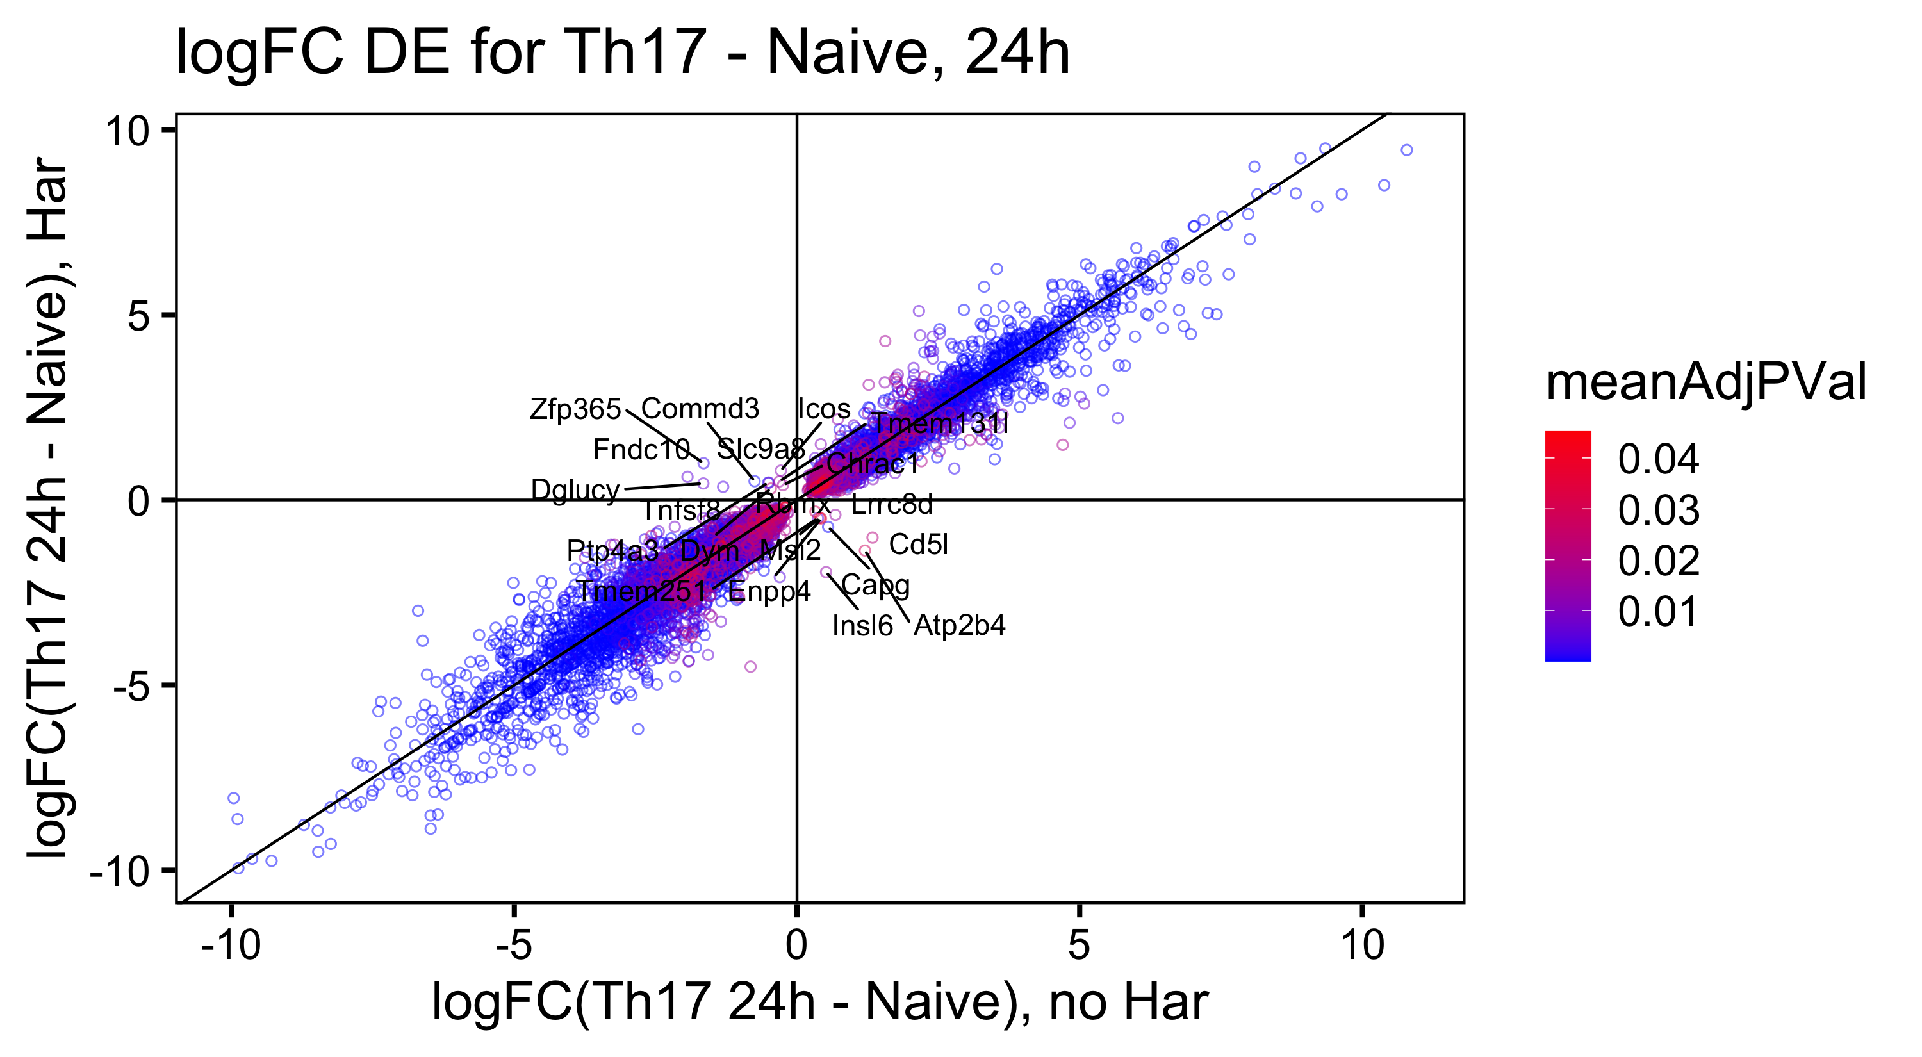

Logfc scatterplot: off-diags are different between the two dge comparisons
DEG overlap:
adj.p.val < 0.05 |LogFC| > 1

Slide 8
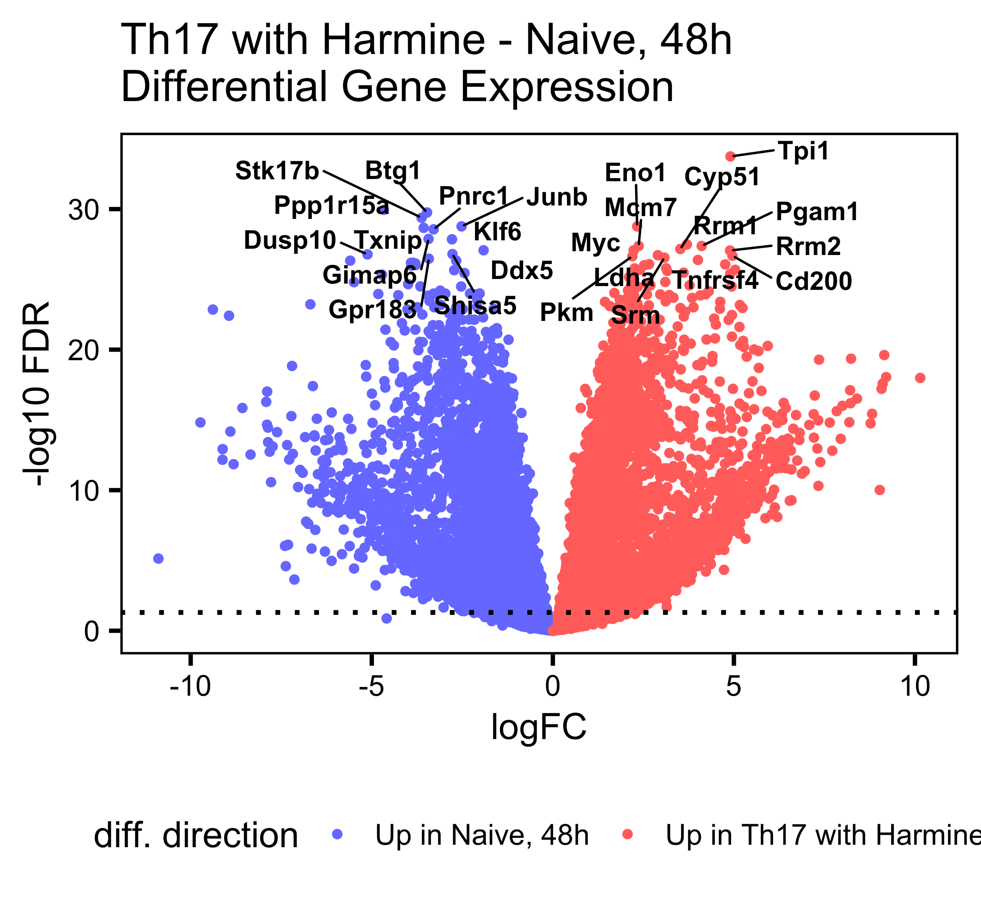
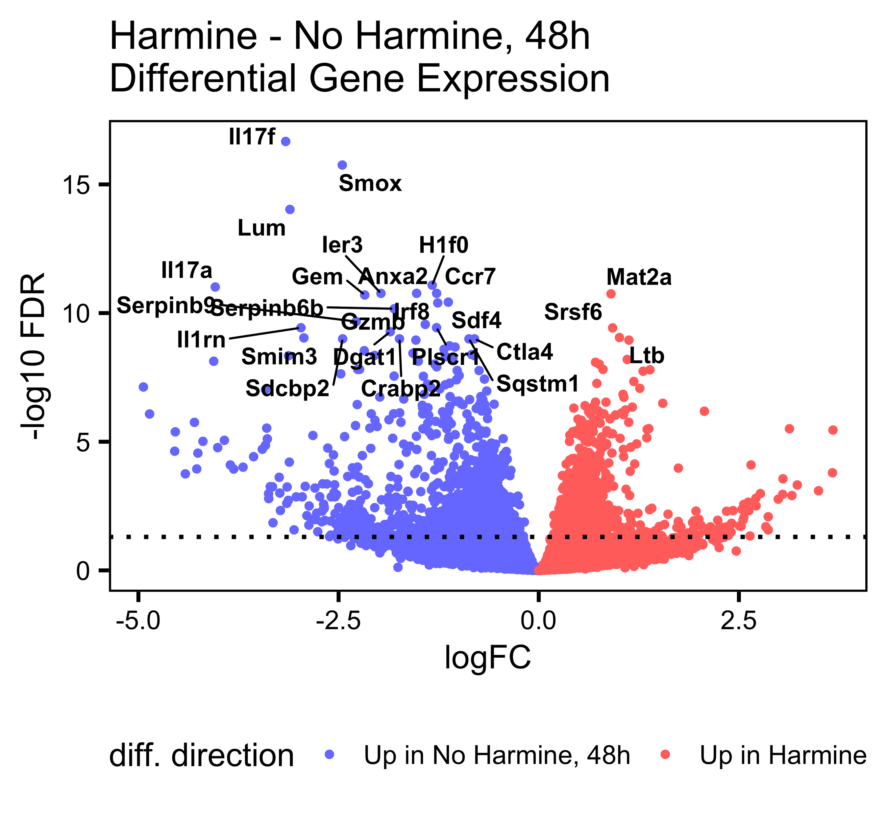
Th17-naïve DGE, 48h, split by harmine

Slide 9
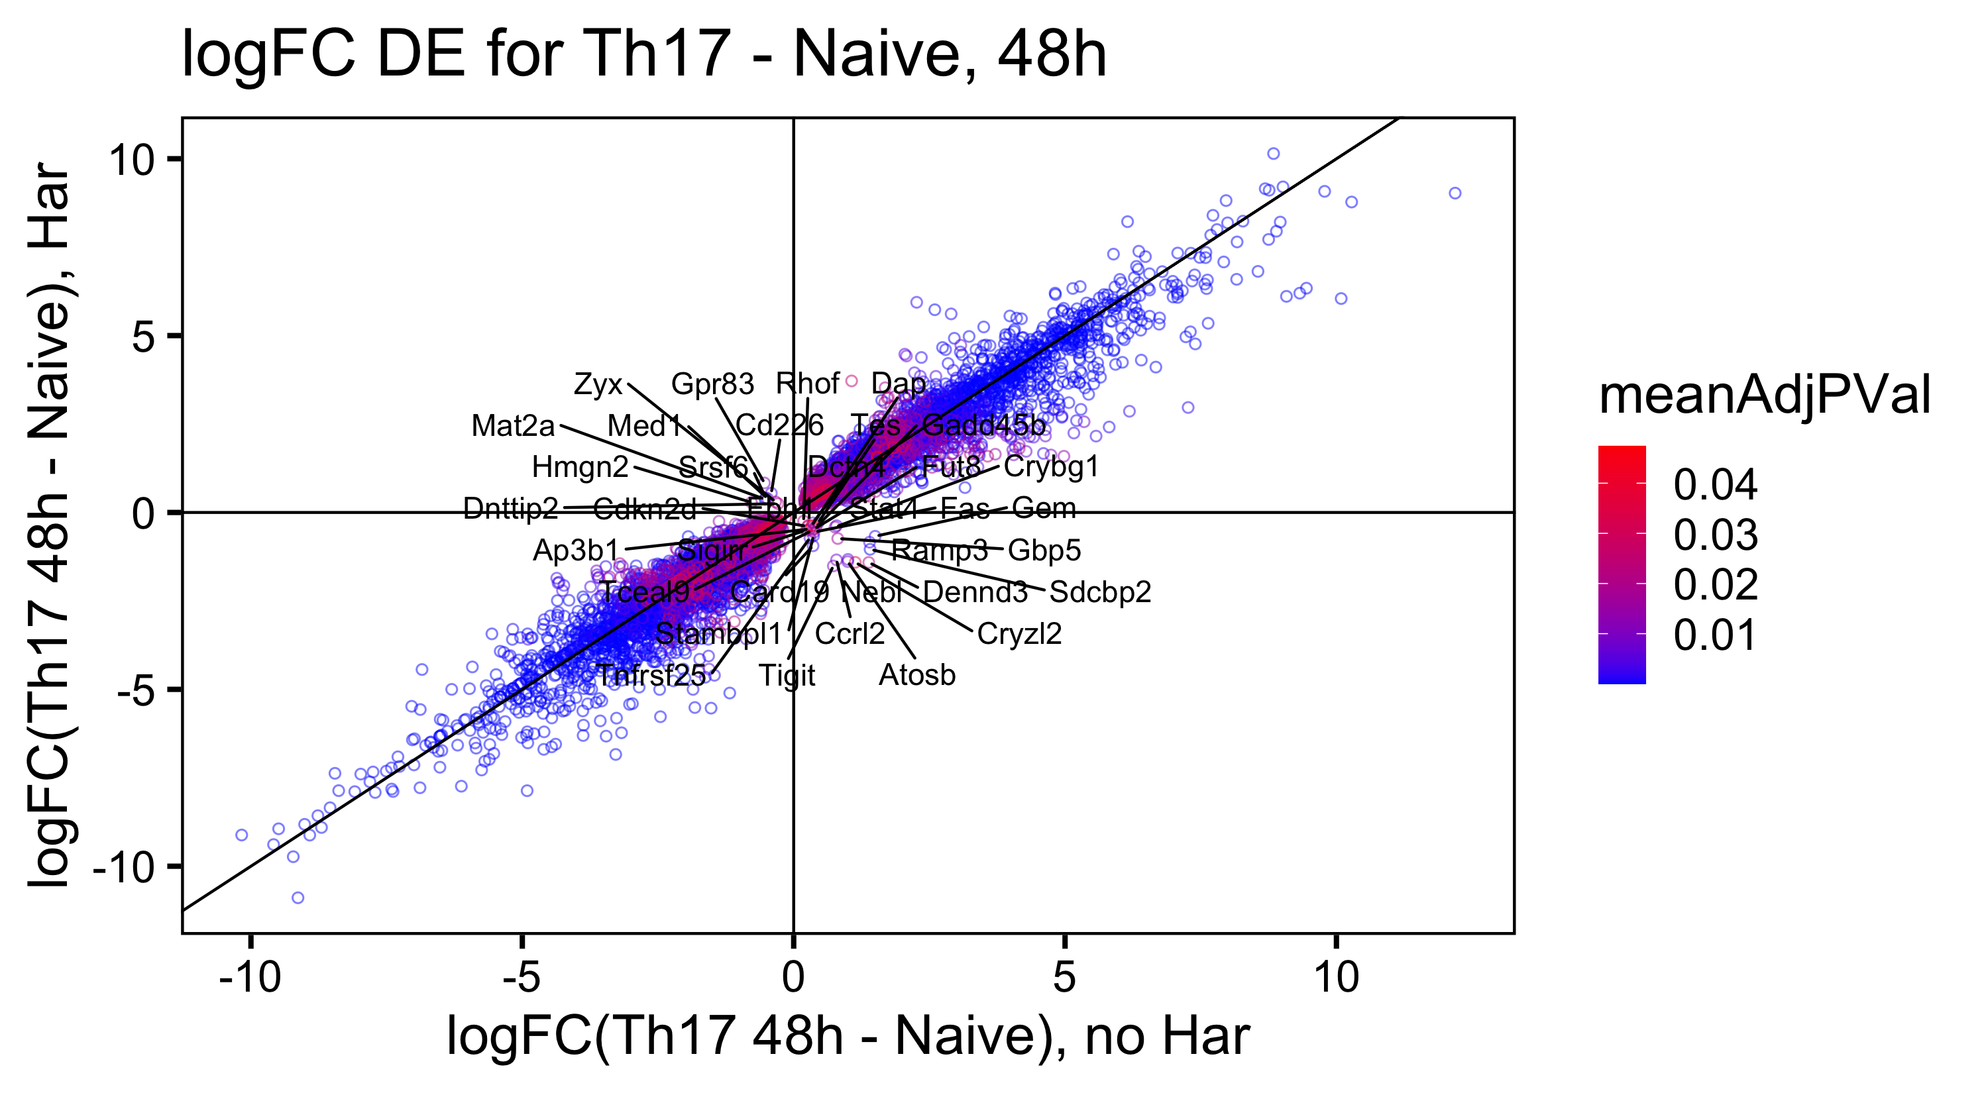

Logfc scatterplot: off-diags are different between the two dge comparisons
DEG overlap:
adj.p.val < 0.05 |LogFC| > 1

Slide 10
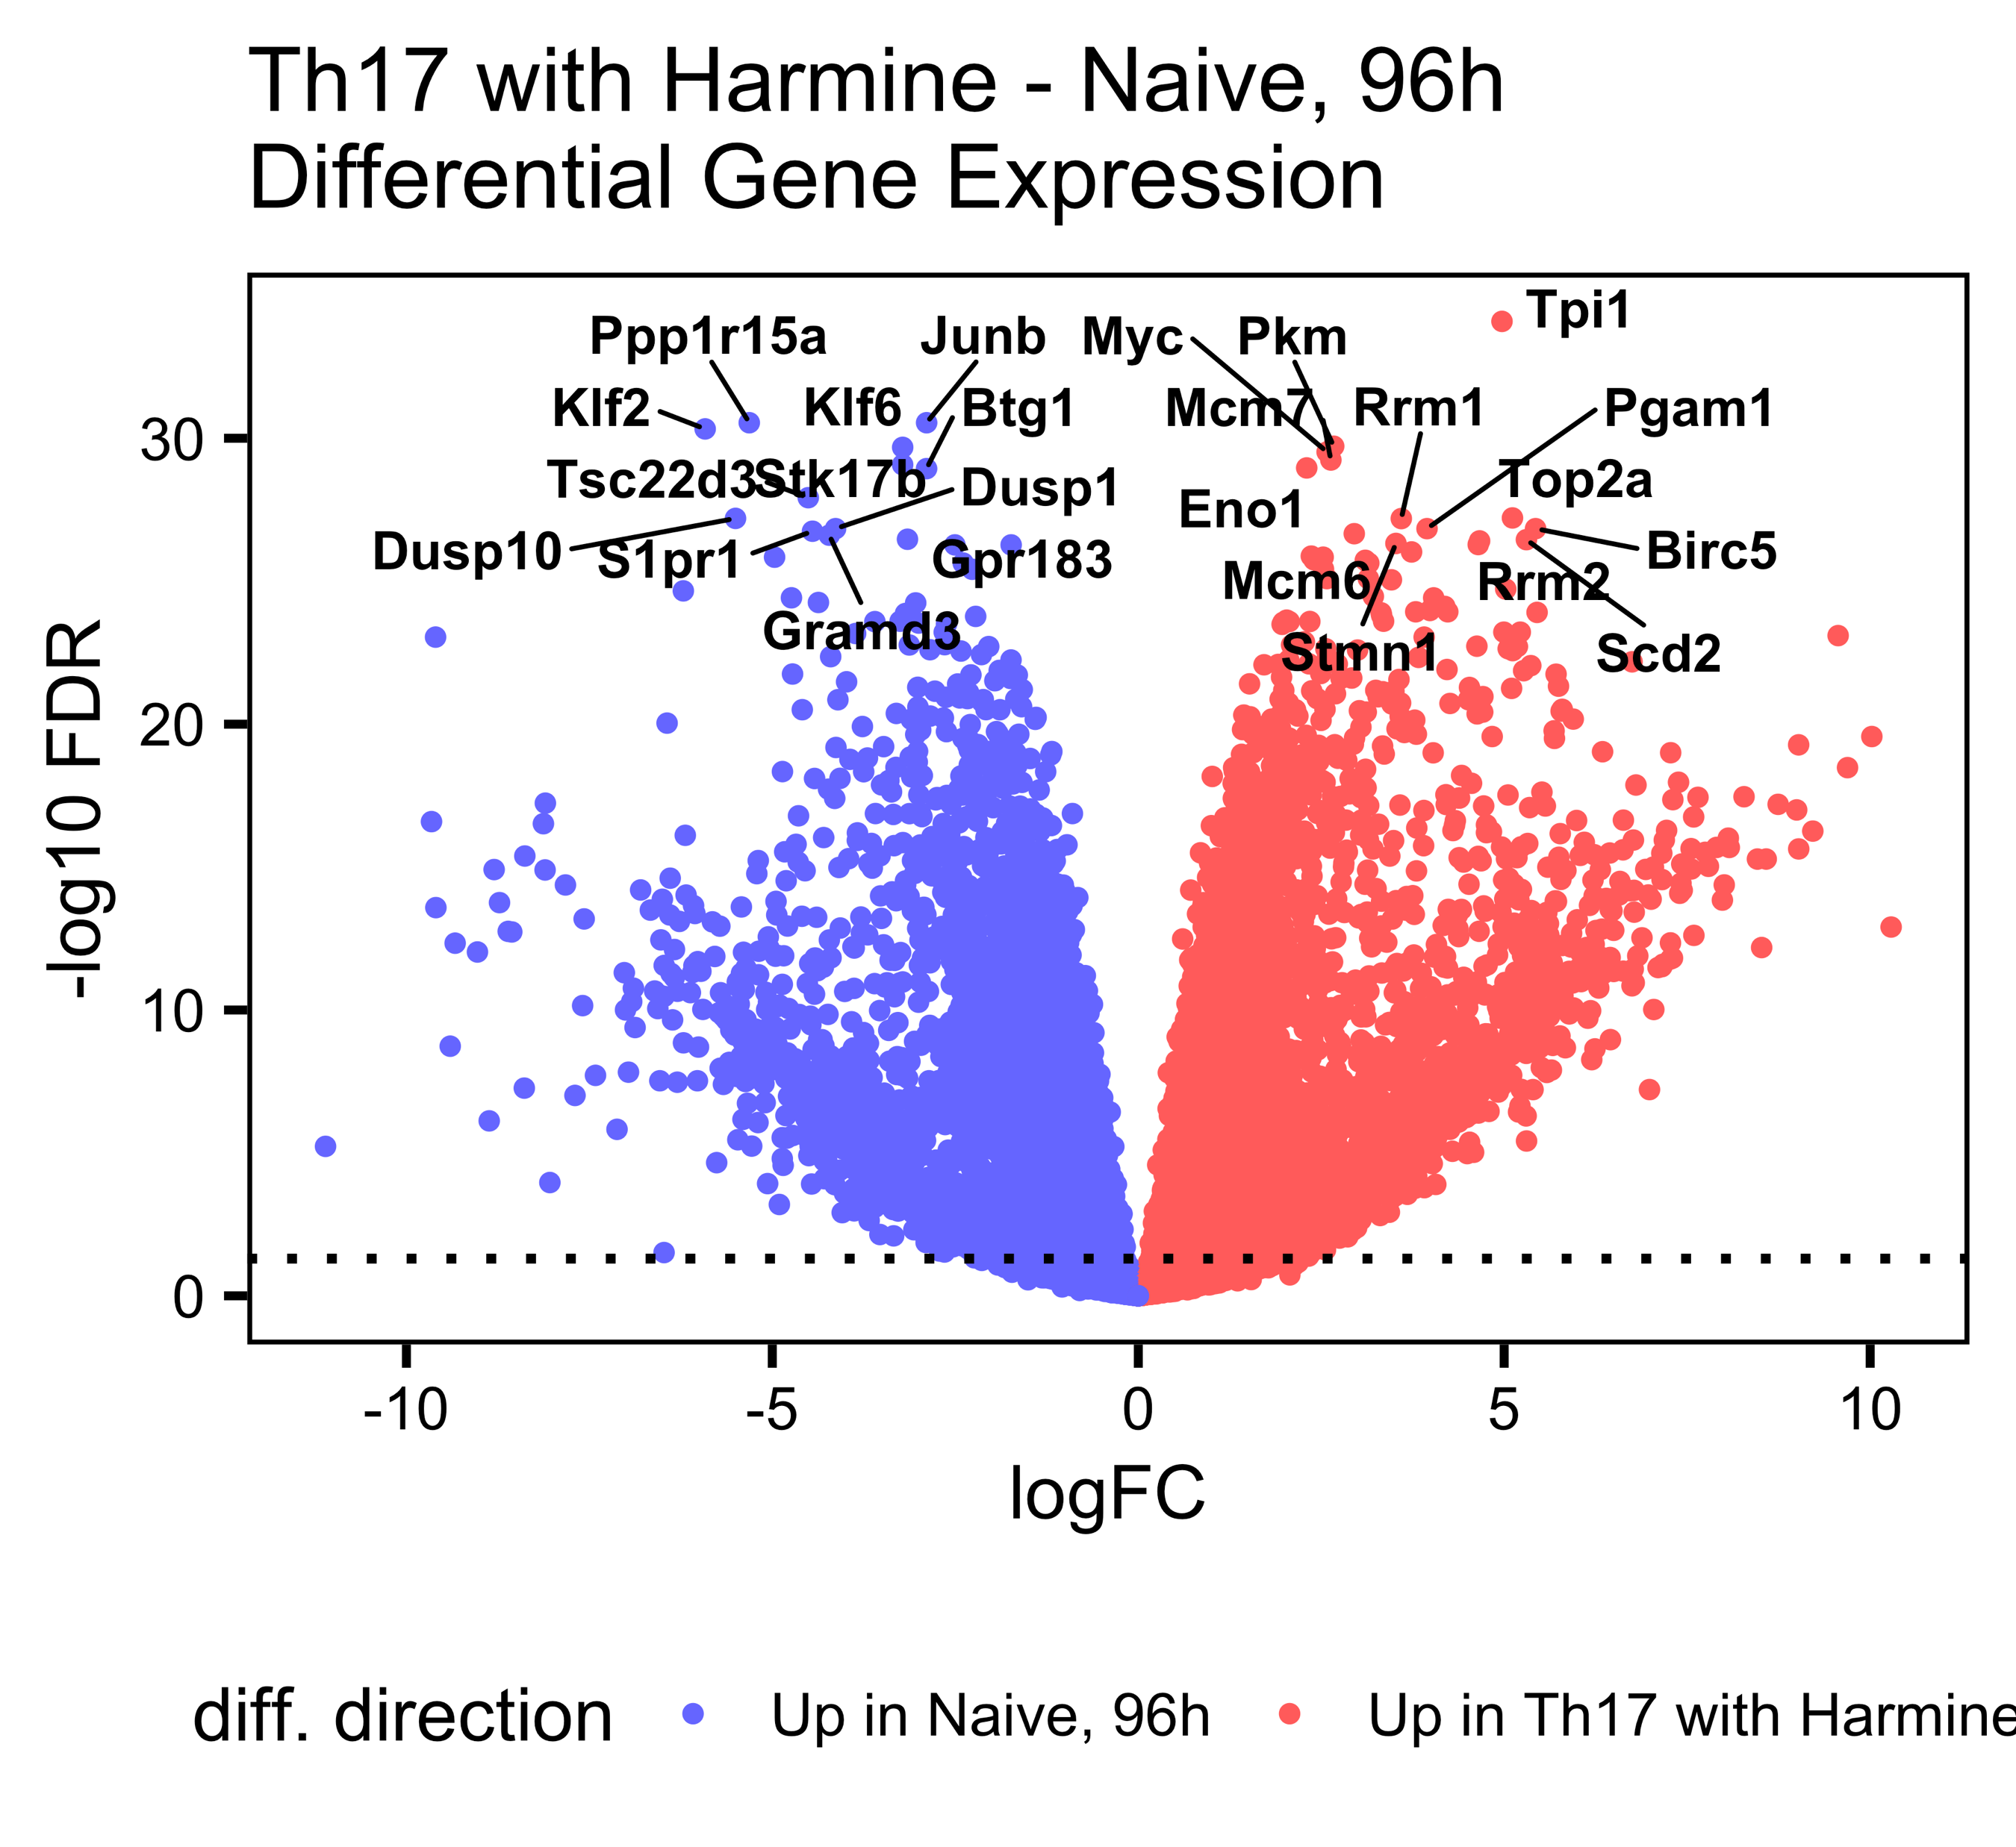
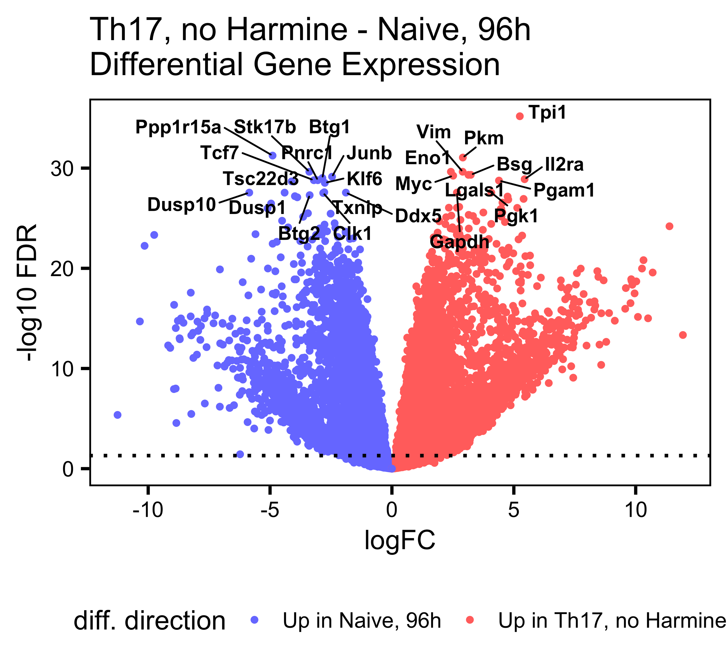
Th17-naïve DGE, 96h, split by harmine

Slide 11
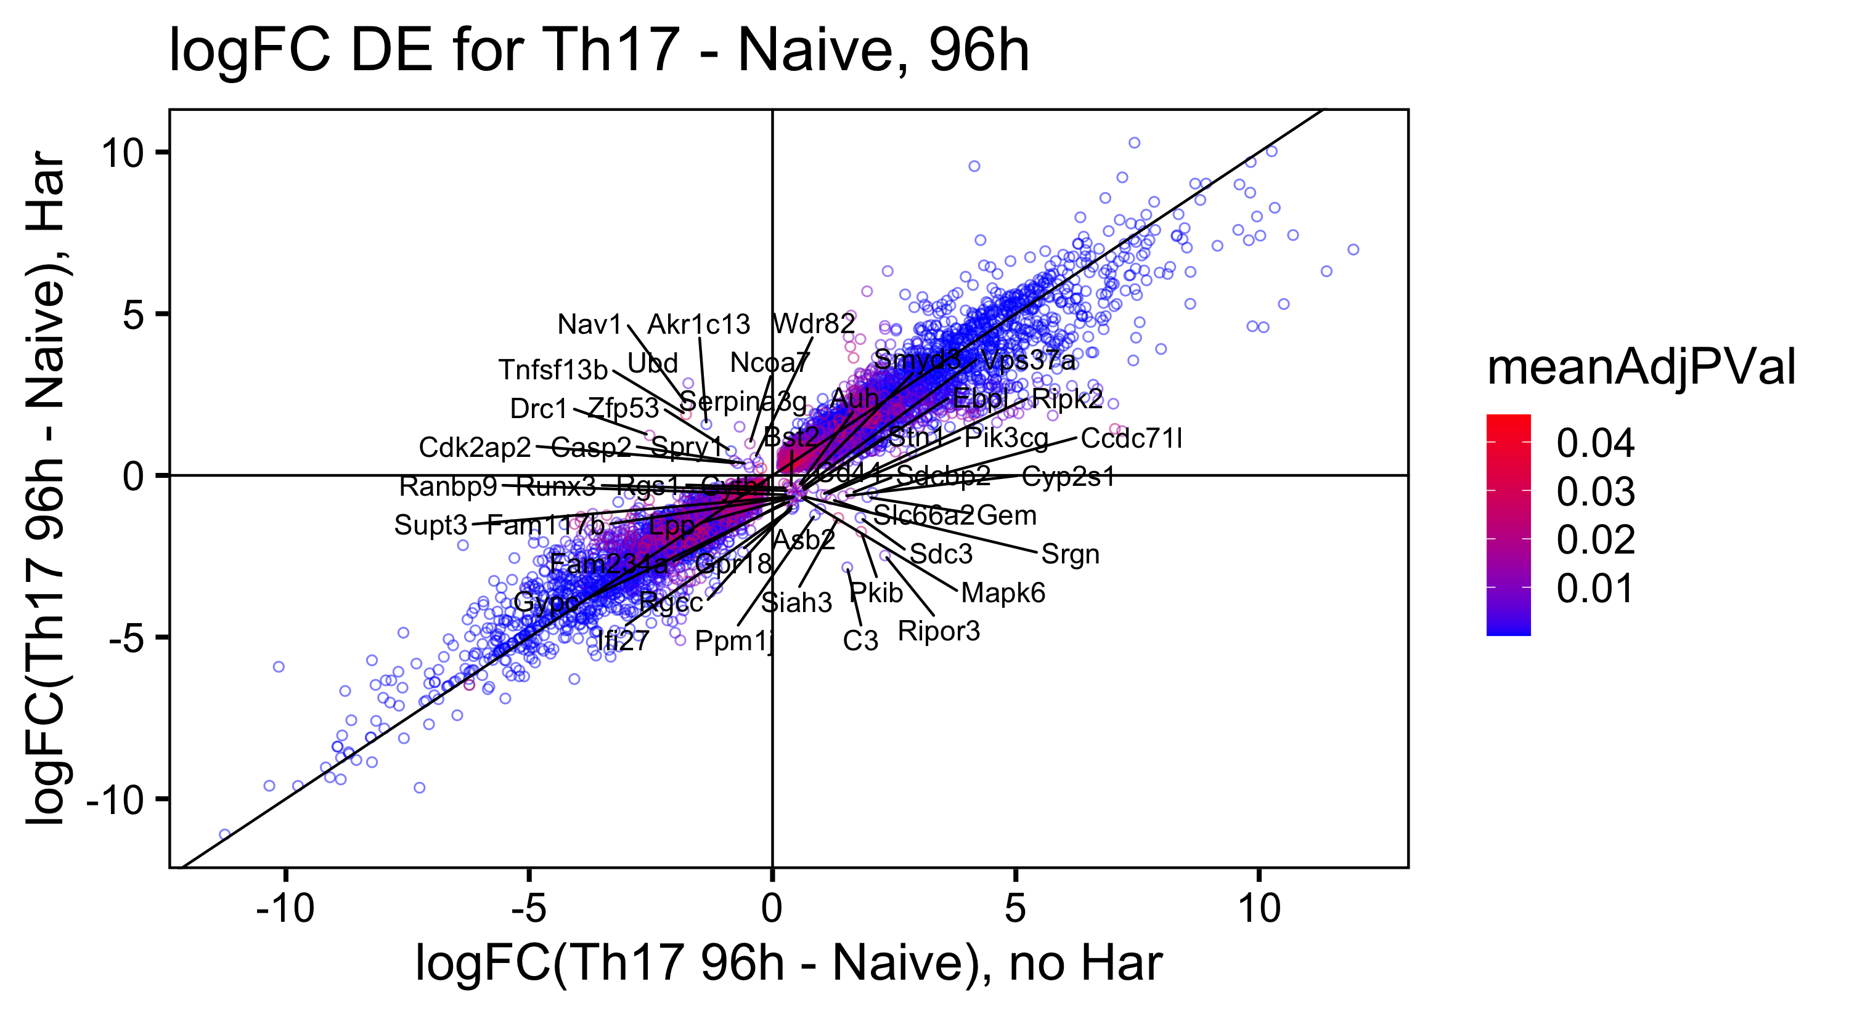
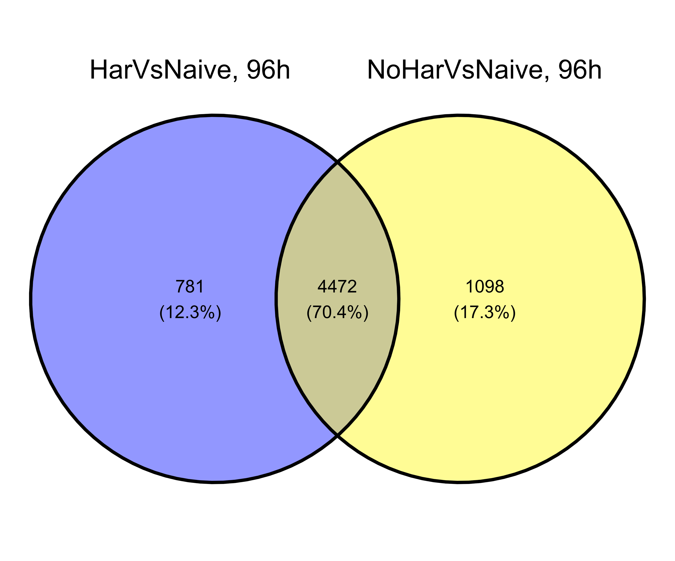
Logfc scatterplot: off-diags are different between the two dge comparisons
DEG overlap:
adj.p.val < 0.05 |LogFC| > 1

Slide 12
Top DEGs, all timepoints

